Slide 1


Workshop

Slide 2

Agenda
Enterprise Workshop Overview
Clinical Concept Review
Additional Topics

Slide 3
Medplum enterprise workshop is designed to accelerate time to business value
Purpose: Provide Medplum best practices for implementation, including:
Data Design
Operational Strategy
Project Planning
Outcome Driven: Each session drives towards a concrete deliverable.
Custom tailored: Focused on your enterprise’s unique challenges.

Slide 4
A typical Medplum implementation begins with clarifying your clinical concepts
Pick a vertical to migrate; migrate a sample set of
Map your clinical concepts to FHIR resources
Define an Encounter model - how do you determine a unit of work for a physician?
Define a CarePlan model - what are protocols for a patient from onboarding to “first unit of work” outcome?
Ho`w to represent recurring patients, chronic or difficult cases, etc
Define your tenancy model - what information is shared between orgs and sub-orgs. How are clinical users managed and assigned
Set up clinical workflows and determine physician review screens
What happens before a patient gets seen, and after their patients get seen?
What clinical context does a physician need
Onboarding champion practitioners to Medplum flow. Identify alpha users who give good feedback and can champion product to team . Test auth and access
Future work: Automate notifications, reminders, etc

Slide 5
Data Modeling Process
Data modeling consists of multiple layers
Structure: Which FHIR resources map to the data elements you are storing?
Terminology: Which codes and code systems represent the specific concepts you are representing.
Lifecycle: What how to model different resource fields as they move through your workflow
Different communities publish implementation guides - guidance on how to use the FHIR spec within a specific context
US Core - Guidance from ONC on how to represent USCDI Data Elements within FHIR.
Lifecycle
Terminology
Structure

Slide 6
01
Clinical Context

Slide 7
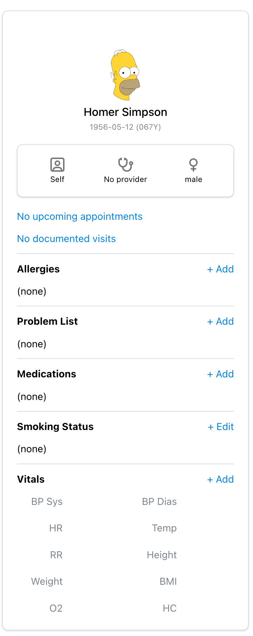
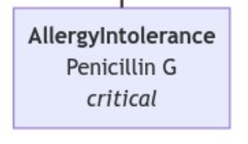
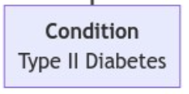
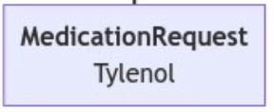
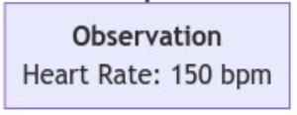
The Clinical Context Model

Slide 8
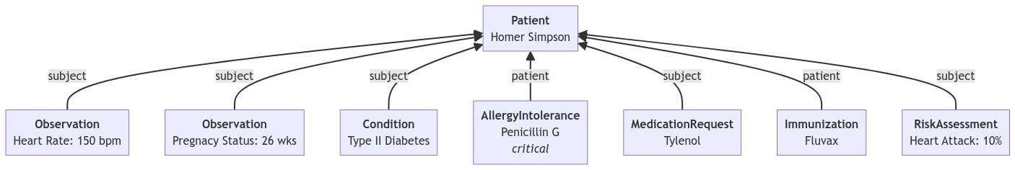
The Clinical Context Model

Slide 9
Observation
Observation: Structured representations of point-in-time clinical measurement.
Can be quantitative (e.g. heart rate) or qualitative (e.g. eye color).
Records
Type
Value
Interpretation
Reference range
Use LOINC codes for compliance, billing, and reporting.
Reference
Capturing Vital Signs
Reference Ranges
LOINC Codes
Applications
Vital Signs
Diagnostic Lab Results
Physical Patient Measurements
Smoking Status

Slide 10
02
Encounters & Charting

Slide 11
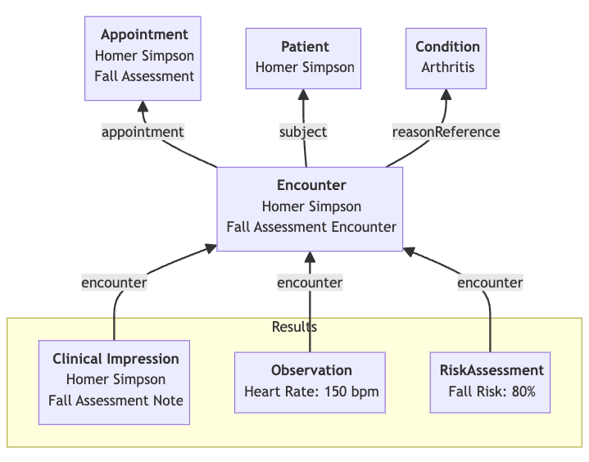
Encounters
Notes:
flowchart BT
app1[<table><thead><tr><th>Appointment</th></tr></thead><tbody><tr><td>Homer Simpson</td></tr><tr><td>Fall Assessment</td><tr></tbody></table>]
encounter[<table><thead><tr><th>Encounter</th></tr></thead><tbody><tr><td>Homer Simpson</td></tr><tr><td>Fall Assessment Encounter</td><tr></tbody></table>]
patient[<table><thead><tr><th>Patient</th></tr></thead><tbody><tr><td>Homer Simpson</td></tr></tbody></table>]
subgraph Results
note[<table><thead><tr><th>Clinical Impression</th></tr></thead><tbody><tr><td>Homer Simpson</td></tr><tr><td>Fall Assessment Note</td><tr></tbody></table>]
obs1[<table><thead><tr><th>Observation</th></tr></thead><tbody><tr><td>Heart Rate: 150 bpm</td></tr></tbody></table>]
ra1[<table><thead><tr><th>RiskAssessment</th></tr></thead><tbody><tr><td>Fall Risk: 80%</td></tr></tbody></table>]
end
encounter -->|appointment| app1
encounter -->|subject| patient
note -->|encounter| encounter
obs1 -->|encounter| encounter
ra1 -->|encounter| encounter

Slide 12
Encounters
Encounter: Primary tracking resource for a visit (in-person or virtual)
Annotate with CPT & ICD-10 codes for billing
ClinicalImpression: Medplum-advised resource for recording unstructured notes

Slide 13

Asynchronous Encounters

Slide 14
03
Care Plans

Slide 15
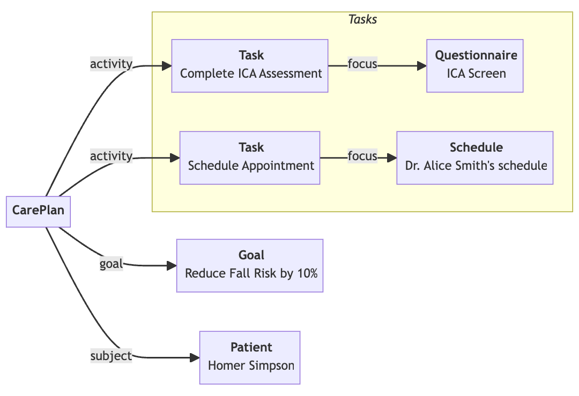
Notes:
CarePlan
Task, Focal Resource
Goal
flowchart LR
CarePlan[<b>CarePlan</b>]
Goal[<table><thead><tr><th>Goal</th></tr></thead><tbody><tr><td>Reduce Fall Risk by 10%</td></tr></tbody></table>]
subgraph tasks [<i>Tasks</i>]
T1[<table><thead><tr><th>Task</th></tr></thead><tbody><tr><td>Complete ICA Assessment</td></tr></tbody></table>]
T2[<table><thead><tr><th>Task</th></tr></thead><tbody><tr><td>Schedule Appointment</td></tr></tbody></table>]
F1[<table><thead><tr><th>Questionnaire</th></tr></thead><tbody><tr><td>ICA Screen</td></tr></tbody></table>]
F2[<table><thead><tr><th>Schedule</th></tr></thead><tbody><tr><td>Dr. Alice Smith's schedule</td></tr></tbody></table>]
T1 -->|focus| F1
T2 -->|focus| F2
end
CarePlan-->|subject| D[<table><thead><tr><th>Patient</th></tr></thead><tbody><tr><td>Homer Simpson</td></tr></tbody></table>]
CarePlan -->|goal| Goal
CarePlan -->|activity| T1
CarePlan -->|activity| T2

Slide 16
Care Plans
Task: Workhorse resource defining all clinical work items to be completed
Tasks can be assigned to an individual practitioner, or to given practitioner role
Task.focus defines the resource that requires action
See the Task Management Guide for more details
Task Application Demo
Goal: Resource to define measurable target to achieve
Use LOINC Codes to define target measure
Optionally set a target due date
A CarePlan can have multiple Goals
CarePlan: Grouping resource to organize a group of Tasks for each patient
Advanced Care Planning
PlanDefinition: Defines a clinical protocol that can be implemented per-patient
RequestGroup: Can define complex relationships between Tasks
Temporal relationships
Recurring Tasks
Mutually Exclusive Tasks
Use Bots to update CarePlans based on business logic and data definitions

Slide 17
04
Intake & Assessments

Slide 18
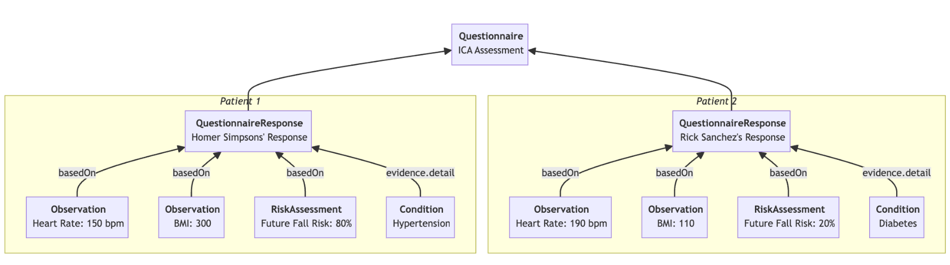
Assessments
Notes:
flowchart BT
Q[<table><thead><tr><th>Questionnaire</th></tr></thead><tbody><tr><td>ICA Assessment</td></tr></tbody></table>]
subgraph p1 [<i>Patient 1</i>]
QR1[<table><thead><tr><th>QuestionnaireResponse</th></tr></thead><tbody><tr><td>Homer Simpsons' Response</td></tr></tbody></table>]
Obs11[<table><thead><tr><th>Observation</th></tr></thead><tbody><tr><td>Heart Rate: 150 bpm</td></tr></tbody></table>] -->|basedOn| QR1
Obs12[<table><thead><tr><th>Observation</th></tr></thead><tbody><tr><td>BMI: 300</td></tr></tbody></table>] -->|basedOn| QR1
RA11[<table><thead><tr><th>RiskAssessment</th></tr></thead><tbody><tr><td>Future Fall Risk: 80%</td></tr></tbody></table>] -->|basedOn| QR1
condition1[<table><thead><tr><th>Condition</th></tr></thead><tbody><tr><td>Hypertension</td></tr></tbody></table>] -->|evidence.detail| QR1
end
subgraph p2 [<i>Patient 2</i>]
QR2[<table><thead><tr><th>QuestionnaireResponse</th></tr></thead><tbody><tr><td>Rick Sanchez's Response</td></tr></tbody></table>]
Obs21[<table><thead><tr><th>Observation</th></tr></thead><tbody><tr><td>Heart Rate: 190 bpm</td></tr></tbody></table>] -->|basedOn| QR2
Obs22[<table><thead><tr><th>Observation</th></tr></thead><tbody><tr><td>BMI: 110 </td></tr></tbody></table>] -->|basedOn| QR2
RA21[<table><thead><tr><th>RiskAssessment</th></tr></thead><tbody><tr><td>Future Fall Risk: 20%</td></tr></tbody></table>] -->|basedOn| QR2
condition2[<table><thead><tr><th>Condition</th></tr></thead><tbody><tr><td>Diabetes</td></tr></tbody></table>] -->|evidence.detail| QR2
end
QR1 --> Q
QR2 --> Q

Slide 19
Assessments
Questionnaire: Definition of questions/answers. 1 per form.
Prefer standard assessments where available
Tag each question / answer with appropriate LOINC codes for reporting.
LOINC has predefined standard assessments
NLM form builder can generate standardized assessments in FHIR format
QuestionnaireResponse: Patient’s responses to each question. 1 per patient, per instance.
Observation & RiskAssessment: Structured representations of the point-in-time results measured by an assessment
RiskAssessment is a specialized form of Observation, tailored to propensity measurements
Use Bots to parse QuestionnaireResponse and compute scores (Guide).
Annotate with LOINC codes for compliance, billing, and reporting.
Condition: Records a long-term diagnosis for a patient
Annotate with ICD-10 codes for billing
Use Bots to update status with new information

Slide 20
05
Care Teams

Slide 21
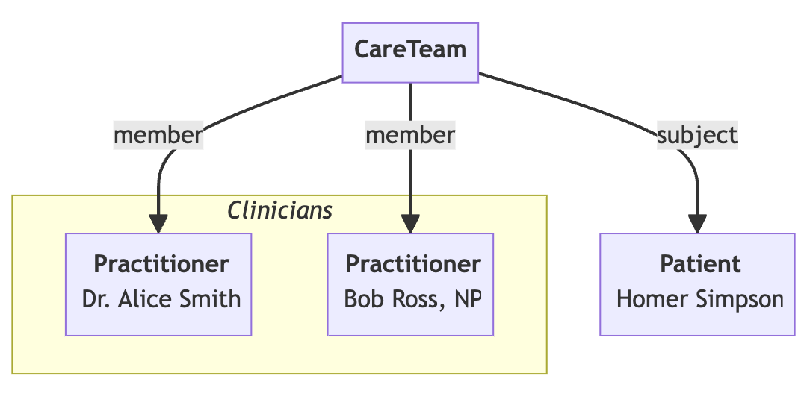
Notes:
flowchart TD
A[<b>CareTeam</b>]
subgraph clinicians [<i>Clinicians</i>]
B[ <table><thead><tr><th>Practitioner</th></tr></thead><tbody><tr><td>Dr. Alice Smith</td></tr></tbody></table>]
C[ <table><thead><tr><th>Practitioner</th></tr></thead><tbody><tr><td>Bob Ross, NP</td></tr></tbody></table>]
end
A-->|member| B
A-->|member| C
A-->|subject| D[<table><thead><tr><th>Patient</th></tr></thead><tbody><tr><td>Homer Simpson</td></tr></tbody></table>]

Slide 22
Care Teams
Role | SNOMED Code
Primary Care Physician | 446050000
Registered Nurse | 224535009
Social Worker | 106328005
Physical Therapist | 36682004
Occupational Therapist | 80546007
Recreational Therapist | 308191009
Dietitian | 159033005
Center Manager | 159441000
Home Care Coordinator | 768730001
Personal Care Attendant | 768836001
Driver | 236320001
CareTeam: Definition of a group of providers assembled for a specific patient.
Careteam.participant field defines the function of each provider
Use SNOMED codes to annotate roles.
Practitioner: Defines the profile of each provider
Used as the profile resource during login
Can be synced to 3rd party system for user registration via Bots

